Slide 1
Evolution over time of the structure of social graphs
Student Leonardo Serilli
Supervisors Frédéric Giroire, Nicolas Nisse, Malgorzata Sulkowska
Year 2021/2022

Slide 2
INTRODUCTION
01
STATE OF THE ART
02
DEGREE DISTRIBUTION
DATA PREPARATION
TABLE OF CONTENTS
04
03
VERTEX TRAJECTORIES
05
06
NEXT STEPS
Context
Scope of the project
Data
Network evolution over time
Power law and scale free networks
Power law in real world networks
Theoretical model
Matching model
Degree Distribution Retrieval
Degree Distribution Fitting
Which researchers should be taken into account?
How to interpret a time step?
Average Trajectories
Fitting Trajectories
General Fitting
Results

Slide 3
01
INTRODUCTION
Context
Scope of the project
Data
1

Slide 4
CONTEXT
Scopus Database
2

Slide 5

CONTEXT
Scopus Database
2

Slide 6
CONTEXT
Scopus Database
250K computer science authors
Collaborations (co-authorship relationship) between 1990 and 2018
2

Slide 7
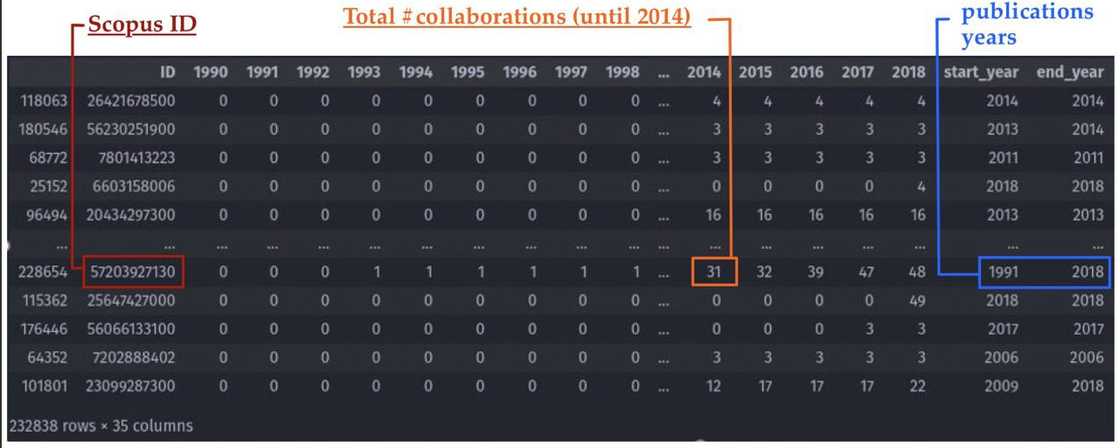
CONTEXT
Scopus Database
250K computer science authors
Collaborations (co-authorship relationship) between 1990 and 2018
2

Slide 8
SCOPE OF THE PROJECT
Build the collaboration network G=(V,E) | V = {authors}, E = {collaborations}.
3

Slide 9
SCOPE OF THE PROJECT
Build the collaboration network G=(V,E) | V = {authors}, E = {collaborations}.
Study some of it's mathematical properties and their evolution over time.
3

Slide 10
SCOPE OF THE PROJECT
Build the collaboration network G=(V,E) | V = {authors}, E = {collaborations}.
Study some of it's mathematical properties and their evolution over time.
Implement a model to generate similar graphs and so able to predict their evolution .
3

Slide 11
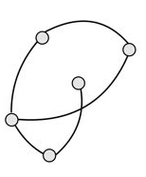
SCOPE OF THE PROJECT
Build the collaboration network G=(V,E) | V = {authors}, E = {collaborations}.
Study some of it's mathematical properties and their evolution over time.
Implement a model to generate similar graphs and so able to predict their evolution .
G₁₉₉₀
3

Slide 12
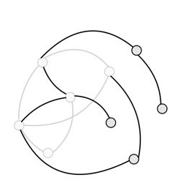
SCOPE OF THE PROJECT
Build the collaboration network G=(V,E) | V = {authors}, E = {collaborations}.
Study some of it's mathematical properties and their evolution over time.
Implement a model to generate similar graphs and so able to predict their evolution .
G₁₉₉₁
G₁₉₉₀
3

Slide 13
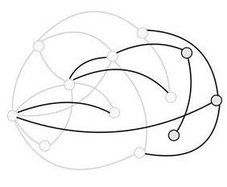
SCOPE OF THE PROJECT
Build the collaboration network G=(V,E) | V = {authors}, E = {collaborations}.
Study some of it's mathematical properties and their evolution over time.
Implement a model to generate similar graphs and so able to predict their evolution .
G₁₉₉₂
G₁₉₉₁
G₁₉₉₀
3

Slide 14
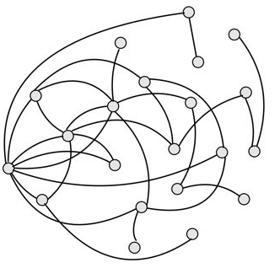
SCOPE OF THE PROJECT
Build the collaboration network G=(V,E) | V = {authors}, E = {collaborations}.
Study some of it's mathematical properties and their evolution over time.
Implement a model to generate similar graphs and so able to predict their evolution .
G₂₀₁₈
G₁₉₉₂
G₁₉₉₁
G₁₉₉₀
3
3

Slide 15
RELEVANT PROPERTIES
Vertex trajectory: d_{v}(y) degree of v at the given year y.
4

Slide 16
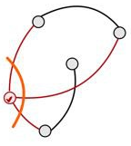
RELEVANT PROPERTIES
Vertex trajectory: d_{v}(y) degree of v at the given year y.
dv(1990)= 3
4

Slide 17
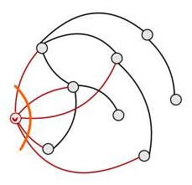
RELEVANT PROPERTIES
Vertex trajectory: d_{v}(y) degree of v at the given year y.
dv(1991)= 5
dv(1990)= 3
4

Slide 18
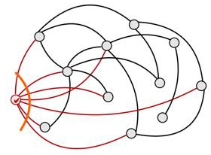
RELEVANT PROPERTIES
Vertex trajectory: d_{v}(y) degree of v at the given year y.
dv(1992)= 7
dv(1991)= 5
dv(1990)= 3
4

Slide 19
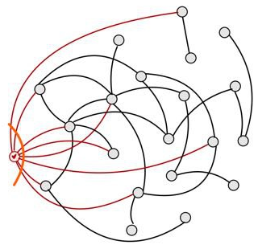
RELEVANT PROPERTIES
Vertex trajectory: d_{v}(y) degree of v at the given year y.
dv(2018)= 8
dv(1992)= 7
dv(1991)= 5
dv(1990)= 3
4

Slide 20
RELEVANT PROPERTIES
Vertex trajectory: d_{v}(y) degree of v at the given year y.
4

Slide 21
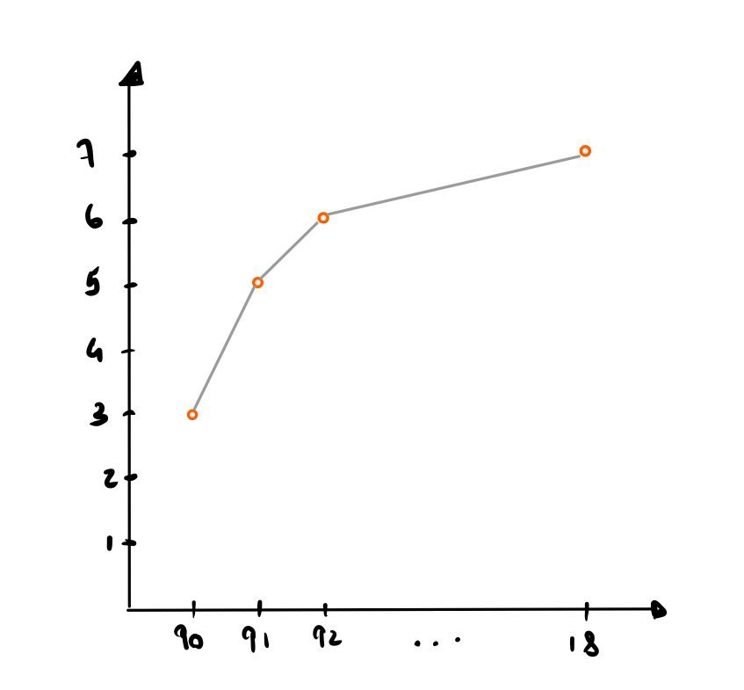
RELEVANT PROPERTIES
Vertex trajectory: d_{v}(y) degree of v at the given year y.
d_{v}(y)
y
4

Slide 22
RELEVANT PROPERTIES
Vertex trajectory: d_{v}(y) degree of v at the given year y.
Degree Distribution: M_{k} = n_{k}/n | n_{k} = #nodes of degree k in G.
5

Slide 23
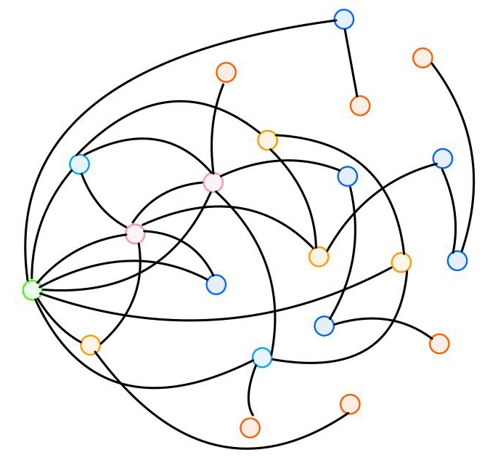
RELEVANT PROPERTIES
Vertex trajectory: d_{v}(y) degree of v at the given year y.
Degree Distribution: M_{k} = n_{k}/n | n_{k} = #nodes of degree k in G.
G₂₀₁₈
5

Slide 24
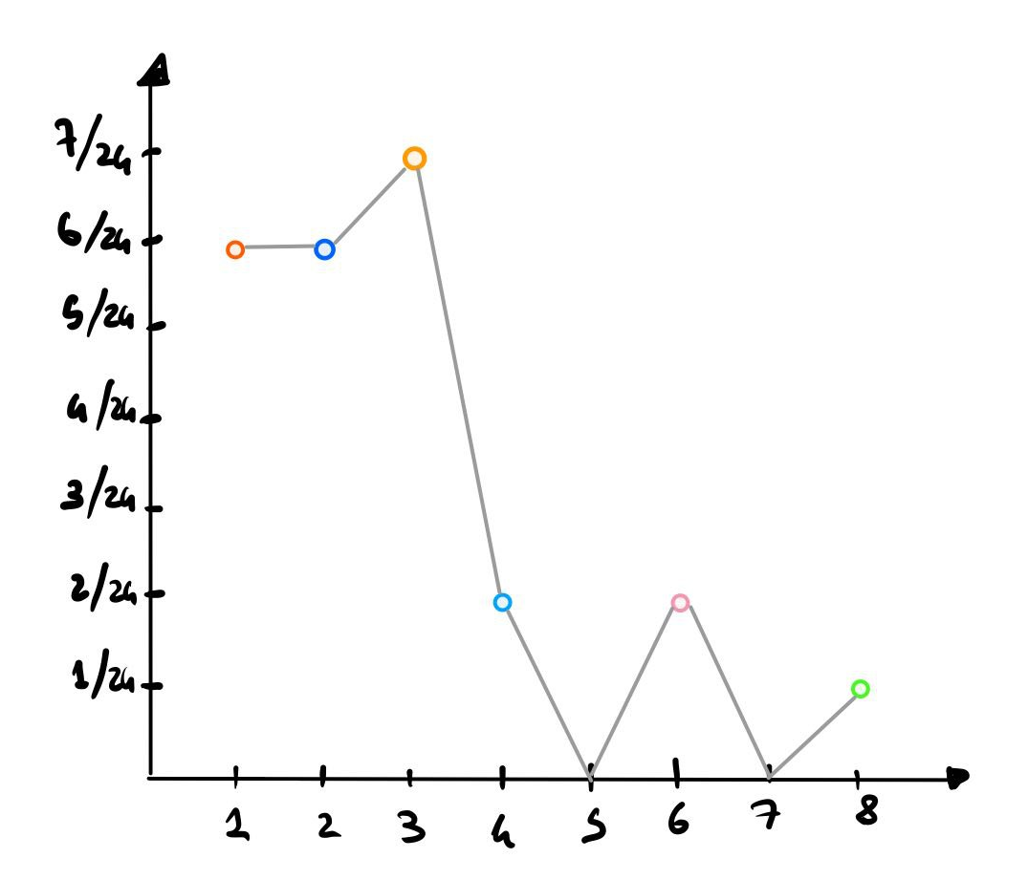
RELEVANT PROPERTIES
Vertex trajectory: d_{v}(y) degree of v at the given year y.
Degree Distribution: M_{k} = n_{k}/n | n_{k} = #nodes of degree k in G.
G₂₀₁₈
Mk
k
5

Slide 25
02
STATE OF THE ART
Network evolution over time
Power law and scale free networks
Power law in real world networks
Theoretical model
Matching model
6

Slide 26
NETWORK EVOLUTION OVER TIME
G = (V, E) evolves over time.
7

Slide 27
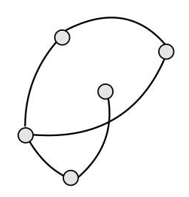
NETWORK EVOLUTION OVER TIME
G = (V, E) evolves over time.
Two kinds of event:
7

Slide 28
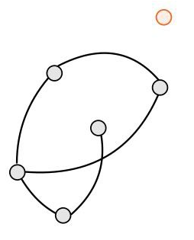
NETWORK EVOLUTION OVER TIME
G = (V, E) evolves over time.
Two kinds of event:
Node + Edge event, probability p
7

Slide 29
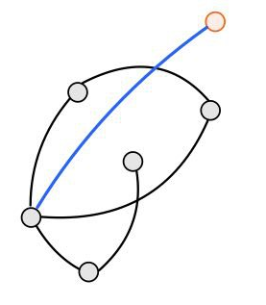
NETWORK EVOLUTION OVER TIME
G = (V, E) evolves over time.
Two kinds of event:
Node + Edge event, probability p
7

Slide 30
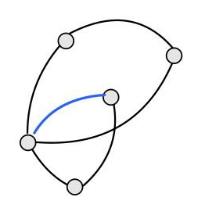
NETWORK EVOLUTION OVER TIME
G = (V, E) evolves over time.
Two kinds of event:
Node + Edge event, probability p
Edge event, probability (1-p)
7

Slide 31
NETWORK EVOLUTION OVER TIME
G = (V, E) evolves over time.
Two kinds of event:
Node + Edge event, probability p
Edge event, probability (1-p)
Let t∈N - #events occurred​
G_{t} = (V_{t}, E_{t}) graph after event t
7

Slide 32
NETWORK EVOLUTION OVER TIME
G = (V, E) evolves over time.
Two kinds of event:
Node + Edge event, probability p
Edge event, probability (1-p)
G_{t+1} = (V_{t+1}, E_{t+1})
Gt = (Vt, Et)
G_{t+1} = (V_{t+1}, E_{t+1})
Let t∈N - #events occurred​
G_{t} = (V_{t}, E_{t}) graph after event t
7

Slide 33
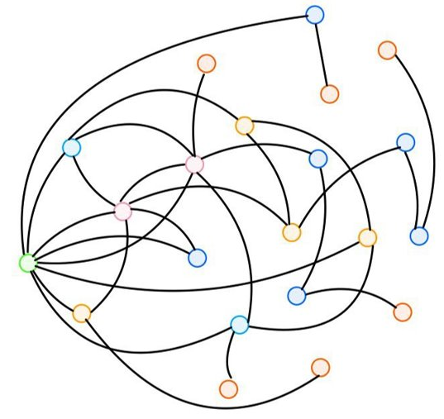
POWER LAW AND SCALE-FREE NETWORKS
G = (V, E) of n nodes
G
G
8

Slide 34
POWER LAW AND SCALE-FREE NETWORKS
G = (V, E) of n nodes
M_{k}
G
G
k
8

Slide 35
POWER LAW AND SCALE-FREE NETWORKS
G = (V, E) of n nodes
.
Degree Distribution M_{k} = n_{k} /n | n_{k} = #nodes of degree k in G.
M_{k}
G
k
8

Slide 36
POWERLAW AND SCALE-FREE NETWORKS
G = (V, E) of n nodes
.
Degree Distribution M_{k} = n_{k} /n | n_{k} = #nodes of degree k in G.
A scale-free network respects the power law distribution M_{k} ∼ Ck^{-λ} | λ, C > 0.
M_{k}
G
k
8

Slide 37
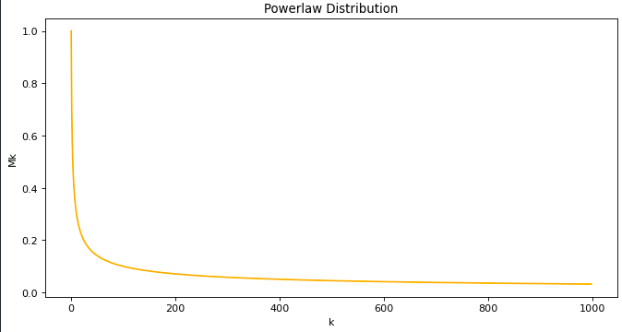
POWERLAW AND SCALE-FREE NETWORKS
G = (V, E) of n nodes
.
Degree Distribution M_{k} = n_{k} /n | n_{k} = #nodes of degree k in G.
A scale-free network respects the power law distribution M_{k} ∼ Ck^{-λ} | λ, C > 0.
M_{k}
G
k
8

Slide 38
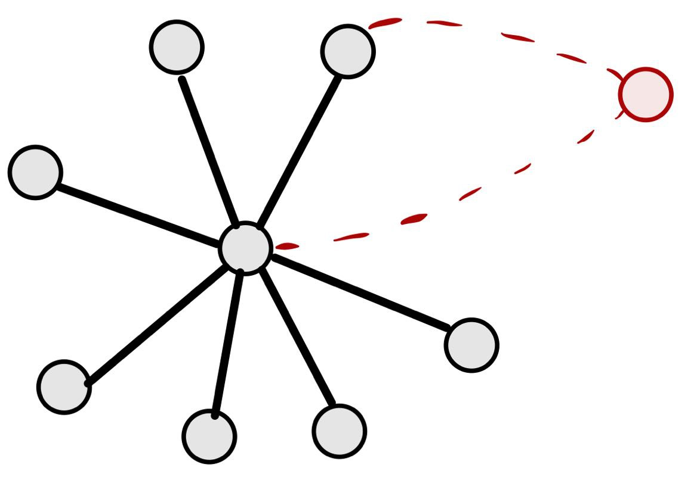
POWERLAW AND SCALE-FREE NETWORKS
G = (V, E) of n nodes
.
Degree Distribution M_{k} = n_{k} /n | n_{k} = #nodes of degree k in G.
A scale-free network respects the power law distribution M_{k} ∼ Ck^{-λ} | λ, C > 0.
M_{k}
G
k
Low Probability
High Probability
8

Slide 39
POWERLAW IN REAL WORLD NETWORKS
Is often believed that most real-world networks are scale-free [1], [2], [3].
9

Slide 40
POWERLAW IN REAL WORLD NETWORKS
Is often believed that most real-world networks are scale-free [1], [2], [3].
References:
[1] Derek J. de Solla P. Networks of scientific papers, 1965, doi:10.1126/science.149.3683.510.
[2] Michalis F., Petros F., and Christos F. On power-law relationships of the Internet topology, 1999, doi:10.1145/316188.316229.
[3] Bollobás B. and Riordan O. Handbook of Graphs and Networks: From the Genome to the Internet, 2003. Pages 1–34.
9

Slide 41
POWERLAW IN REAL WORLD NETWORKS
Is often believed that most real-world networks are scale-free [1], [2], [3].
Powerlaw M_{k} ∼ Ck^{-λ}
References:
[1] Derek J. de Solla P. Networks of scientific papers, 1965, doi:10.1126/science.149.3683.510.
[2] Michalis F., Petros F., and Christos F. On power-law relationships of the Internet topology, 1999, doi:10.1145/316188.316229.
[3] Bollobás B. and Riordan O. Handbook of Graphs and Networks: From the Genome to the Internet, 2003. Pages 1–34.
9

Slide 42
POWERLAW IN REAL WORLD NETWORKS
Is often believed that most real-world networks are scale-free [1], [2], [3].
Powerlaw M_{k} ∼ Ck^{-λ}
References:
[1] Derek J. de Solla P. Networks of scientific papers, 1965, doi:10.1126/science.149.3683.510.
[2] Michalis F., Petros F., and Christos F. On power-law relationships of the Internet topology, 1999, doi:10.1145/316188.316229.
[3] Bollobás B. and Riordan O. Handbook of Graphs and Networks: From the Genome to the Internet, 2003. Pages 1–34.
9

Slide 43
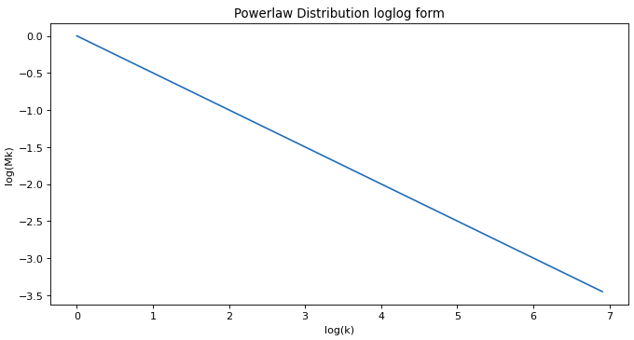
POWERLAW IN REAL WORLD NETWORKS
Is often believed that most real-world networks are scale-free [1], [2], [3].
Powerlaw M_{k} ∼ Ck^{-λ}
References:
[1] Derek J. de Solla P. Networks of scientific papers, 1965, doi:10.1126/science.149.3683.510.
[2] Michalis F., Petros F., and Christos F. On power-law relationships of the Internet topology, 1999, doi:10.1145/316188.316229.
[3] Bollobás B. and Riordan O. Handbook of Graphs and Networks: From the Genome to the Internet, 2003. Pages 1–34.
9

Slide 44
POWERLAW IN REAL WORLD NETWORKS
Ubiquitousness of power law has been questioned [4].
References:
[4] Broido A. D.and A. Clauset, “Scale-free networks are rare”, 2019, doi: 10.1038/s41467-019-08746-5.
10

Slide 45
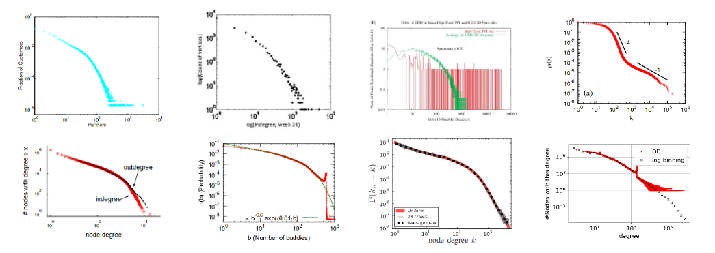
POWERLAW IN REAL WORLD NETWORKS
Ubiquitousness of power law has been questioned [4].
Investigations shown that scale-free networks are not so widespread as thought, it turns out that many of them follow a power-law distribution with an exponential cut-off [5], [6].
(biology, online market, social networks, ...)
References:
[4] Broido A. D.and A. Clauset, “Scale-free networks are rare”, 2019, doi: 10.1038/s41467-019-08746-5.
[5] Newman M. E. J. Coauthorship networks and patterns of scientific collaboration, 2004, doi:10.1073/pnas.0307545100.
[6] Newman M. E. J. Clustering and preferential attachment in growing networks, 2001, doi:10.1103/PhysRev
10

Slide 46
POWERLAW IN REAL WORLD NETWORKS
Ubiquitousness of power law has been questioned [4].
Investigations shown that scale-free networks are not so widespread as thought, it turns out that many of them follow a power-law distribution with an exponential cut-off [5], [6].
Powerlaw with exponential cut-off M_{k} ∼ Ck^{-λ}γ^{-k} | 0≤γ<1​
References:
[4] Broido A. D.and A. Clauset, “Scale-free networks are rare”, 2019, doi: 10.1038/s41467-019-08746-5.
[5] Newman M. E. J. Coauthorship networks and patterns of scientific collaboration, 2004, doi:10.1073/pnas.0307545100.
[6] Newman M. E. J. Clustering and preferential attachment in growing networks, 2001, doi:10.1103/PhysRev
10

Slide 47
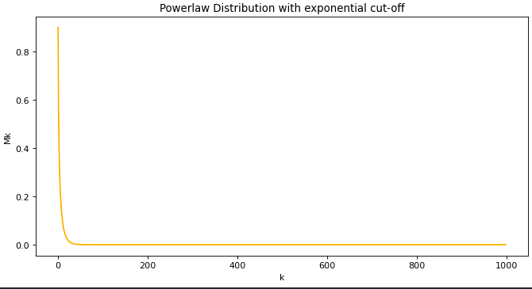
POWERLAW IN REAL WORLD NETWORKS
Ubiquitousness of power law has been questioned [4].
Investigations shown that scale-free networks are not so widespread as thought, it turns out that many of them follow a power-law distribution with an exponential cut-off [5], [6].
Powerlaw with exponential cut-off M_{k} ∼ Ck^{-λ}γ^{-k} | 0≤γ<1​
References:
[4] Broido A. D.and A. Clauset, “Scale-free networks are rare”, 2019, doi: 10.1038/s41467-019-08746-5.
[5] Newman M. E. J. Coauthorship networks and patterns of scientific collaboration, 2004, doi:10.1073/pnas.0307545100.
[6] Newman M. E. J. Clustering and preferential attachment in growing networks, 2001, doi:10.1103/PhysRev
10

Slide 48
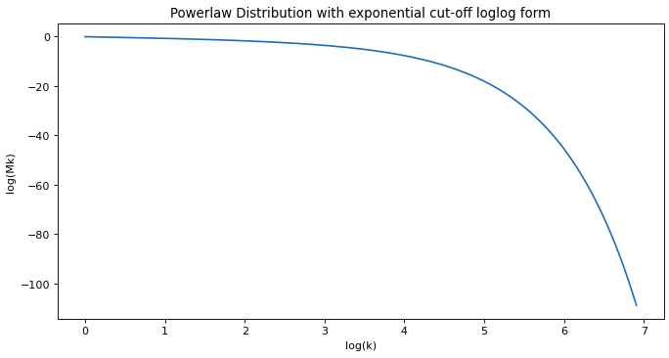
POWERLAW IN REAL WORLD NETWORKS
Ubiquitousness of power law has been questioned [4].
Investigations shown that scale-free networks are not so widespread as thought, it turns out that many of them follow a power-law distribution with an exponential cut-off [5], [6].
Powerlaw with exponential cut-off M_{k} ∼ Ck^{-λ}γ^{-k} | 0≤γ<1​
References:
[4] Broido A. D.and A. Clauset, “Scale-free networks are rare”, 2019, doi: 10.1038/s41467-019-08746-5.
[5] Newman M. E. J. Coauthorship networks and patterns of scientific collaboration, 2004, doi:10.1073/pnas.0307545100.
[6] Newman M. E. J. Clustering and preferential attachment in growing networks, 2001, doi:10.1103/PhysRev
10
Notes:
Note the gamma parameter, it gives the exponential cut-off, but where that parameter comes from? (see next)

Slide 49
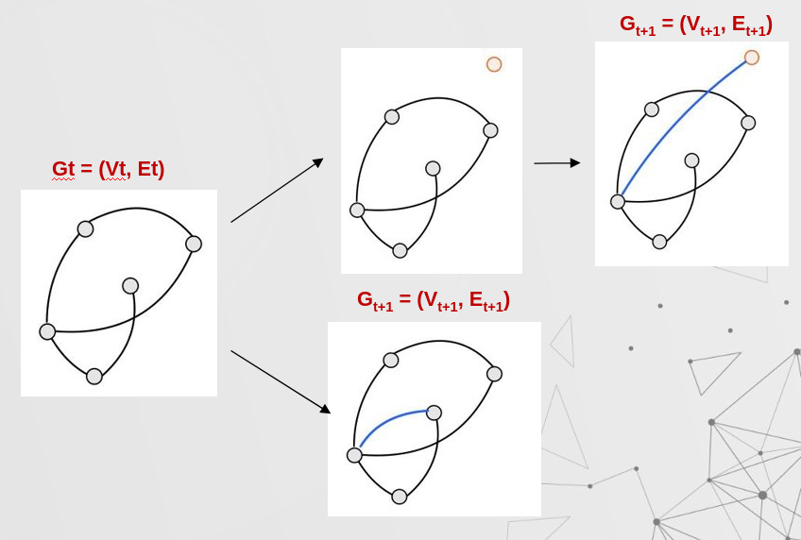
THEORETICAL MODEL
(Node + Edge) event​, p
Edge event, (1-p)
11

Slide 50
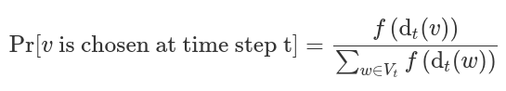
THEORETICAL MODEL
(Node + Edge) event​, p
Edge event, (1-p)
11

Slide 51
THEORETICAL MODEL
(Node + Edge) event​, p
Edge event, (1-p)
The preferrential attachment is dictated by the so called attachment function f(d_{v}(t)) = d_{v}(t)^{γ}
11

Slide 52
THEORETICAL MODEL
(Node + Edge) event​, p
Edge event, (1-p)
The preferrential attachment is dictated by the so called attachment function f(d_{v}(t)) = d_{v}(t)^{γ}
11

Slide 53
THEORETICAL MODEL
(Node + Edge) event​, p
Edge event, (1-p)
The preferrential attachment is dictated by the so called attachment function f(d_{v}(t)) = d_{v}(t)^{γ}
Vertex trajectory:
11

Slide 54
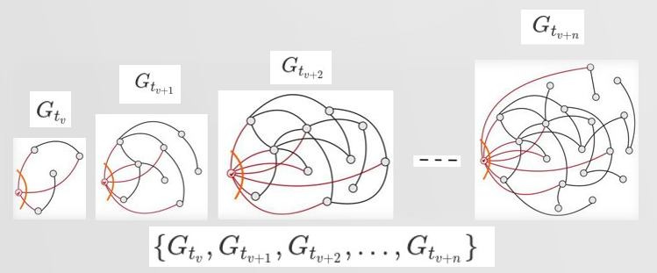
THEORETICAL MODEL
(Node + Edge) event​, p
Edge event, (1-p)
The preferrential attachment is dictated by the so called attachment function f(d_{v}(t)) = d_{v}(t)^{γ}
Vertex trajectory:
Let t_{v} time step in which v appears in the graph;
11

Slide 55
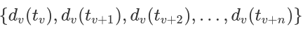
THEORETICAL MODEL
(Node + Edge) event​, p
Edge event, (1-p)
The preferrential attachment is dictated by the so called attachment function f(d_{v}(t)) = d_{v}(t)^{γ}
Vertex trajectory:
Let t_{v} time step in which v appears in the graph;
The vertex trajectory d_{v}(t) is the sequence:
11

Slide 56
MATCHING MODEL
Barabasi Albert model [7]
Given:
P = 1, so only node+edge event
γ = 1, so f(d_{v}(t)) = d_{v}(t)
References:
[7] Barabasi A. and Albert R. Emergence of Scaling in Random Networks. 1999, Pages 509–12, doi: 10.1126/science.286.5439.509.5
12

Slide 57
MATCHING MODEL
Barabasi Albert model [7]
Given:
P = 1, so only node+edge event
γ = 1, so f(d_{v}(t)) = d_{v}(t)
Follows:
Power law degree distribution M_{k} ∼ Ck^{-λ} ​
Vertext trajectory d_{v}(t) = (t/t_{v})^{1/2}​
References:
[7] Barabasi A. and Albert R. Emergence of Scaling in Random Networks. 1999, Pages 509–12, doi: 10.1126/science.286.5439.509.5
12

Slide 58
MATCHING MODEL
Barabasi Albert model [7]
Given:
P = 1, so only node+edge event
γ = 1, so f(d_{v}(t)) = d_{v}(t)
Follows:
Power law degree distribution M_{k} ∼ Ck^{-λ} ​
Vertext trajectory d_{v}(t) = (t/t_{v})^{1/2}​
Chung-Lu model [8]
Given:
General P and 0≤γ<1
Generalized sublinear f(d_{v}(t)) = d_{v}(t)^{γ}
References:
[7] Barabasi A. and Albert R. Emergence of Scaling in Random Networks. 1999, Pages 509–12, doi: 10.1126/science.286.5439.509.5
[8] Giroire F., Nisse N., Sulkowska M., Study of a degree distribution and a vertex trajectory in the Chung-Lu model with a generalized attachment function, 2022
[10] Chung F. and Lu L., Complex Graphs and Networks, 2006.
12

Slide 59
MATCHING MODEL
Barabasi Albert model [7]
Given:
P = 1, so only node+edge event
γ = 1, so f(d_{v}(t)) = d_{v}(t)
Follows:
Power law degree distribution M_{k} ∼ Ck^{-λ} ​
Vertext trajectory d_{v}(t) = (t/t_{v})^{1/2}​
Chung-Lu model [8]
Given:
General P and 0≤γ<1
Generalized sublinear f(d_{v}(t)) = d_{v}(t)^{γ}
Follows :​
stretched exponential degree distribution M_{k}
References:
[7] Barabasi A. and Albert R. Emergence of Scaling in Random Networks. 1999, Pages 509–12, doi: 10.1126/science.286.5439.509.5
[8] Giroire F., Nisse N., Sulkowska M., Study of a degree distribution and a vertex trajectory in the Chung-Lu model with a generalized attachment function, 2022
[10] Chung F. and Lu L., Complex Graphs and Networks, 2006.
12

Slide 60

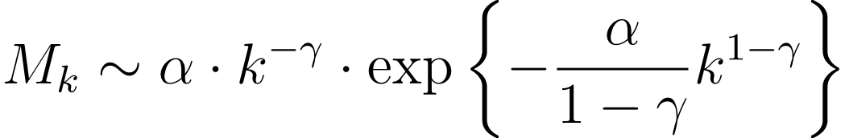
MATCHING MODEL
Barabasi Albert model [7]
Given:
P = 1, so only node+edge event
γ = 1, so f(d_{v}(t)) = d_{v}(t)
Follows:
Power law degree distribution M_{k} ∼ Ck^{-λ} ​
Vertext trajectory d_{v}(t) = (t/t_{v})^{1/2}​
Chung-Lu model [8]
Given:
General P and 0≤γ<1
Generalized sublinear f(d_{v}(t)) = d_{v}(t)^{γ}
Follows :​
stretched exponential degree distribution M_{k}
References:
[7] Barabasi A. and Albert R. Emergence of Scaling in Random Networks. 1999, Pages 509–12, doi: 10.1126/science.286.5439.509.5
[8] Giroire F., Nisse N., Sulkowska M., Study of a degree distribution and a vertex trajectory in the Chung-Lu model with a generalized attachment function, 2022
[10] Chung F. and Lu L., Complex Graphs and Networks, 2006.
12

Slide 61
MATCHING MODEL
Barabasi Albert model [7]
Given:
P = 1, so only node+edge event
γ = 1, so f(d_{v}(t)) = d_{v}(t)
Follows:
Power law degree distribution M_{k} ∼ Ck^{-λ} ​
Vertext trajectory d_{v}(t) = (t/t_{v})^{1/2}​
Chung-Lu model [8]
Given:
General P and 0≤γ<1
Generalized sublinear f(d_{v}(t)) = d_{v}(t)^{γ}
Follows :​
stretched exponential degree distribution M_{k}
logarithmic vertex trajectory d_{v}(t)
References:
[7] Barabasi A. and Albert R. Emergence of Scaling in Random Networks. 1999, Pages 509–12, doi: 10.1126/science.286.5439.509.5
[8] Giroire F., Nisse N., Sulkowska M., Study of a degree distribution and a vertex trajectory in the Chung-Lu model with a generalized attachment function, 2022
[10] Chung F. and Lu L., Complex Graphs and Networks, 2006.
12

Slide 62
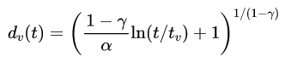
MATCHING MODEL
Barabasi Albert model [7]
Given:
P = 1, so only node+edge event
γ = 1, so f(d_{v}(t)) = d_{v}(t)
Follows:
Power law degree distribution M_{k} ∼ Ck^{-λ} ​
Vertext trajectory d_{v}(t) = (t/t_{v})^{1/2}​
Chung-Lu model [8]
Given:
General P and 0≤γ<1
Generalized sublinear f(d_{v}(t)) = d_{v}(t)^{γ}
Follows :​
stretched exponential degree distribution M_{k}
logarithmic vertex trajectory d_{v}(t)
References:
[7] Barabasi A. and Albert R. Emergence of Scaling in Random Networks. 1999, Pages 509–12, doi: 10.1126/science.286.5439.509.5
[8] Giroire F., Nisse N., Sulkowska M., Study of a degree distribution and a vertex trajectory in the Chung-Lu model with a generalized attachment function, 2022
[10] Chung F. and Lu L., Complex Graphs and Networks, 2006.
12

Slide 63
03
FACED PROBLEMS
(1) Which researchers should be taken into account?
(2) How to interpret a time step?
13

Slide 64
(1) Which researchers should be taken into account?
Problem
We faced the following issues trying to define what an active author is:
14

Slide 65
(1) Which researchers should be taken into account?
Problem
We faced the following issues trying to define what an active author is:
Authors with low publication rate, too many years of inactivity;.
14

Slide 66
(1) Which researchers should be taken into account?
Problem
We faced the following issues trying to define what an active author is:
Authors with low publication rate, too many years of inactivity;
Authors with few years of research activity, like students who stopped publishing after their PhD;
14

Slide 67
(1) Which researchers should be taken into account?
Problem
We faced the following issues trying to define what an active author is:
Authors with low publication rate, too many years of inactivity;
Authors with few years of research activity, like students who stopped publishing after their PhD;
Authors with few publications.
14

Slide 68
(1) Which researchers should be taken into account?
Problems
We faced the following issues trying to define what an active author is:
Authors with low publication rate, too many years of inactivity;
Authors with few years of research activity, like students who stopped publishing after their PhD;
Authors with few publications.
Solutions:
We defined active authors by the following metrics:
14

Slide 69
(1) Which researchers should be taken into account?
Problems
We faced the following issues trying to define what an active author is:
Authors with low publication rate, too many years of inactivity;
Authors with few years of research activity, like students who stopped publishing after their PhD;
Authors with few publications.
Solutions:
We defined active authors by the following metrics:
Hole size: # consecutive years without publishing;
14

Slide 70
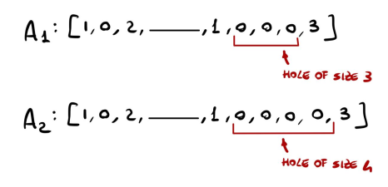
(1) Which researchers should be taken into account?
Problems
We faced the following issues trying to define what an active author is:
Authors with low publication rate, too many years of inactivity;
Authors with few years of research activity, like students who stopped publishing after their PhD;
Authors with few publications.
Solutions:
We defined active authors by the following metrics:
Hole size: # consecutive years without publishing;
14

Slide 71
(1) Which researchers should be taken into account?
Problems
We faced the following issues trying to define what an active author is:
Authors with low publication rate, too many years of inactivity;
Authors with few years of research activity, like students who stopped publishing after their PhD;
Authors with few publications.
Solutions:
We defined active authors by the following metrics:
Hole size: #consecutive years without publishing;
Activity period: #years between 1st and last publication;
14

Slide 72
(1) Which researchers should be taken into account?
Problems
We faced the following issues trying to define what an active author is:
Authors with low publication rate, too many years of inactivity;
Authors with few years of research activity, like students who stopped publishing after their PhD;
Authors with few publications.
Solutions:
We defined active authors by the following metrics:
Hole size: #consecutive years without publishing;
Activity period: #years between 1st and last publication;
Publication number: total #publications.
14

Slide 73
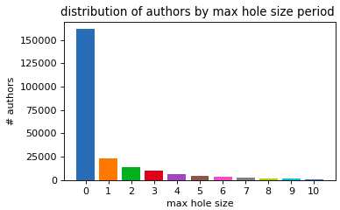
(1) Which researchers should be taken into account?
Hole size
(# consecutive years without publishing)
15

Slide 74
(1) Which researchers should be taken into account?
Hole size
(# consecutive years without publishing)
To include researcher who take a sabathical year from teaching every seven, to do research
≤ 7
15

Slide 75
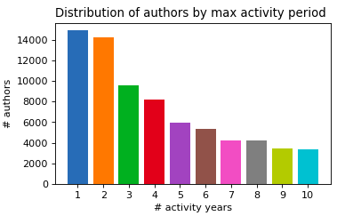
(1) Which researchers should be taken into account?
Hole size
(# consecutive years without publishing)
&
Activity period ​
(#years between 1st and last publication)
To include researcher who take a sabathical year from teaching every seven, to do research
≤ 7
15

Slide 76
(1) Which researchers should be taken into account?
Hole size
(# consecutive years without publishing)
&
Activity period ​
(#years between 1st and last publication)
To include researcher who take a sabathical year from teaching every seven, to do research
To exlude PhD students
≤ 7
≥ 5
15

Slide 77
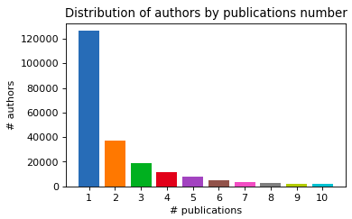
(1) Which researchers should be taken into account?
Hole size
(# consecutive years without publishing)
&
Activity period ​
(#years between 1st and last publication)
&
#publications
To include researcher who take a sabathical year from teaching every seven, to do research
To exlude PhD students
≤ 7
≥ 5
15

Slide 78
(1) Which researchers should be taken into account?
Hole size
(# consecutive years without publishing)
&
Activity period ​
(#years between 1st and last publication)
&
#publications
To include researcher who take a sabathical year from teaching every seven, to do research
To exlude PhD students
Good compromise between insight and #authors filtered
≤ 7
≥ 5
≥ 3
15

Slide 79
(1) Which researchers should be taken into account?
Hole size
(# consecutive years without publishing)
&
Activity period ​
(#years between 1st and last publication)
&
#publications
To include researcher who take a sabathical year from teaching every seven, to do research
To exlude PhD students
Good compromise between insight and #authors filtered
≤ 7
≥ 5
≥ 3
=> 16% of data left
15

Slide 80
(2) How to interpret a time step?
16

Slide 81
(2) How to interpret a time step?
Time step definition: G_{t} = (V_{t}, E_{t}) graph after event t | t∈N - #events occurred ((Node + Edge) and Edge event)
16

Slide 82
(2) How to interpret a time step?
Time step definition: G_{t} = (V_{t}, E_{t}) graph after event t | t∈N - #events occurred ((Node + Edge) and Edge event)
We have the state of the graph for each year, but our model not refer to the year but to the appearance of author or collaboration.
16

Slide 83
(2) How to interpret a time step?
Time step definition: G_{t} = (V_{t}, E_{t}) graph after event t | t∈N - #events occurred ((Node + Edge) and Edge event)
We have the state of the graph for each year, but our model not refer to the year but to the appearance of author or collaboration.
Other metrics as event : the occurrence of a new author
16

Slide 84
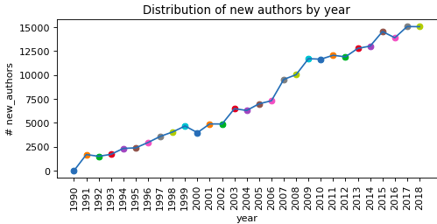
(2) How to interpret a time step?
Time step definition: G_{t} = (V_{t}, E_{t}) graph after event t | t∈N - #events occurred ((Node + Edge) and Edge event)
We have the state of the graph for each year, but our model not refer to the year but to the appearance of author or collaboration.
Other metrics as event : the occurrence of a new author
16

Slide 85
(2) How to interpret a time step?
Time step definition: G_{t} = (V_{t}, E_{t}) graph after event t | t∈N - #events occurred ((Node + Edge) and Edge event)
We have the state of the graph for each year, but our model not refer to the year but to the appearance of author or collaboration.
Other metrics as event : the occurrence of a new author or a new collaboration.
16

Slide 86
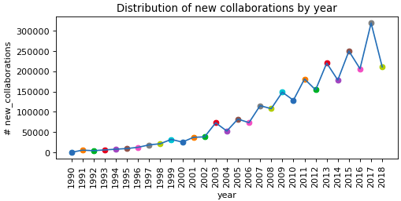
(2) How to interpret a time step?
Time step definition: G_{t} = (V_{t}, E_{t}) graph after event t | t∈N - #events occurred ((Node + Edge) and Edge event)
We have the state of the graph for each year, but our model not refer to the year but to the appearance of author or collaboration.
Other metrics as event : the occurrence of a new author or a new collaboration.
16

Slide 87
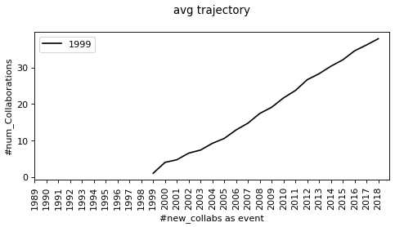
(2) How to interpret a time step?
17

Slide 88
(2) How to interpret a time step?
Vertex trajectories are stretched on the x axis
Shown their logarithmic shape.
17

Slide 89
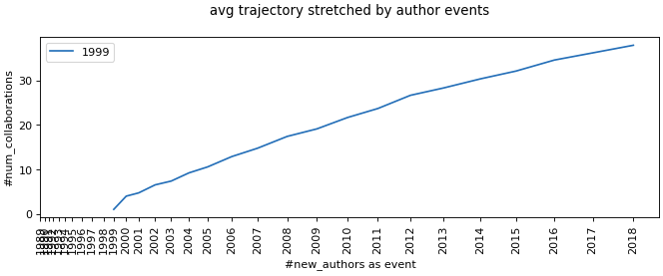
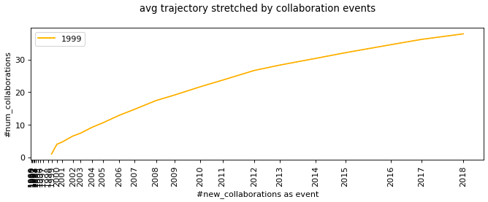
(2) How to interpret a time step?
Vertex trajectories are stretched on the x axis
Shown their logarithmic shape.
17

Slide 90
04
DEGREE DISTRIBUTION
Degree Distribution Retrieval
Degree Distribution Fitting
18

Slide 91
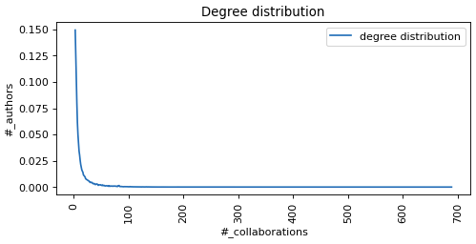
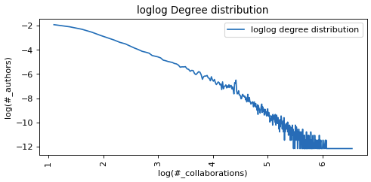
DEGREE DISTRIBUTION RETRIEVAL
To acquire more knowledge from the character of the data the degree distribution of active authors is found, taking the #authors with a given #collaborations. ​
19

Slide 92
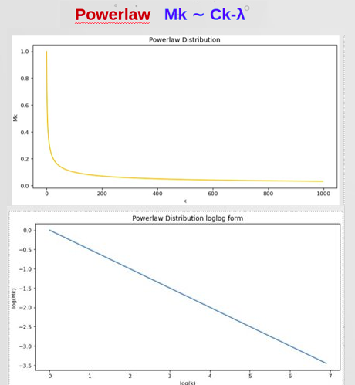
DEGREE DISTRIBUTION FITTING
To acquire more knowledge from the character of the data the degree distribution of active authors is found, taking the #authors with a given #collaborations. ​
20

Slide 93
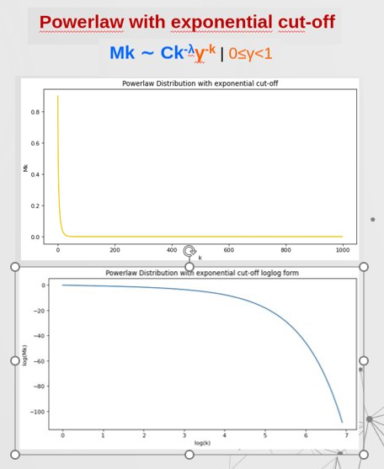
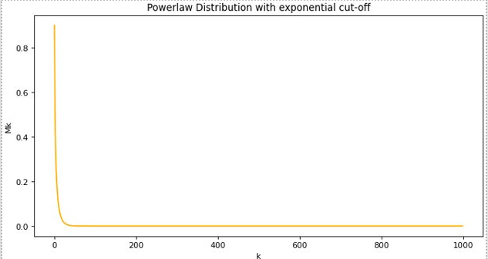

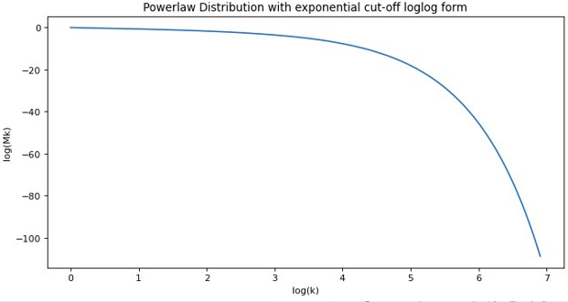
DEGREE DISTRIBUTION FITTING
To acquire more knowledge from the character of the data the degree distribution of active authors is found, taking the #authors with a given #collaborations. ​
20

Slide 94
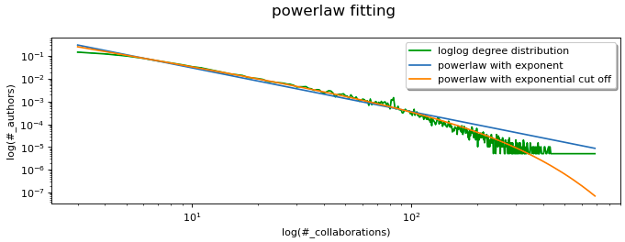
DEGREE DISTRIBUTION RETRIEVAL
To acquire more knowledge from the character of the data the degree distribution of active authors is found, taking the #authors with a given #collaborations. ​
21

Slide 95
05
VERTEX TRAJECTORIES
Average Trajectories
Fitting Trajectories
General Fitting
Final Contraddiction
22

Slide 96
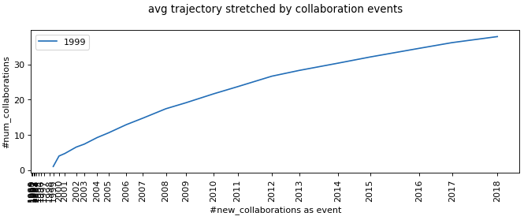
AVERAGE TRAJECTORIES
Computed and plotted the average trajectory of active authors by starting year.
23

Slide 97
AVERAGE TRAJECTORIES
Computed and plotted the average trajectory of active authors by starting year.
The x-axis is stretched by the number of new collaborations as events.
23

Slide 98
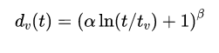
FITTING TRAJECTORIES
Average trajectories are fitted one by one using the logarithmic function representing the theoretical vertex trajectory.
24

Slide 99
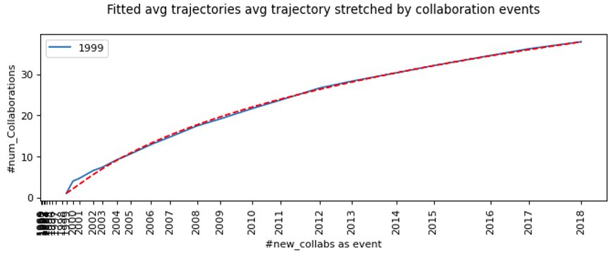
FITTING TRAJECTORIES
Average trajectories are fitted one by one using the logarithmic function representing the theoretical vertex trajectory.
Obtained a couple of individual parameter α, β for each.
24

Slide 100
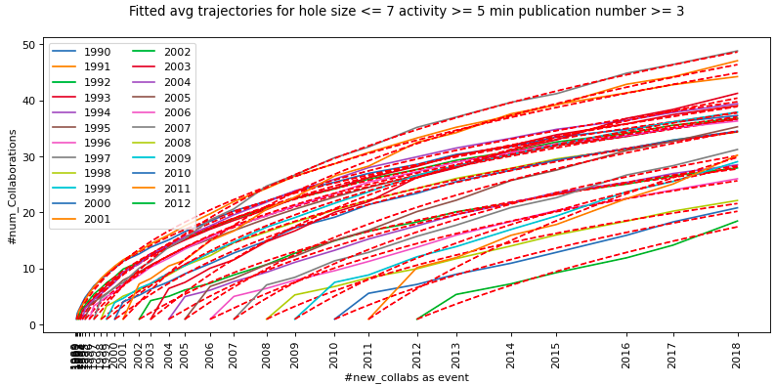
FITTING TRAJECTORIES
25

Slide 101
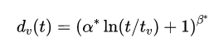
FITTING TRAJECTORIES
26

Slide 102

FITTING TRAJECTORIES
26

Slide 103

FITTING TRAJECTORIES
26

Slide 104
GENERAL FITTING
Find d_{v}(t)=(α* ln(t/t_{v}) + 1)^{β*} | α* and β* fit all curves minimizing the given error.
Four different kinds of errors:
27

Slide 105

GENERAL FITTING
Find d_{v}(t)=(α* ln(t/t_{v}) + 1)^{β*} | α* and β* fit all curves minimizing the given error.
Four different kinds of errors:
27

Slide 106

GENERAL FITTING
Find d_{v}(t)=(α* ln(t/t_{v}) + 1)^{β*} | α* and β* fit all curves minimizing the given error.
Four different kind of errors:
27

Slide 107

GENERAL FITTING (1996)
28

Slide 108

GENERAL FITTING (2000)
29

Slide 109

FINAL CONTRADDICTION
Real Data
​M_{k}
30

Slide 110
FINAL CONTRADDICTION
Real Data
Theoretical model
0≤γ<1 ​
f(d_{v}(t)) = dv(t)^{γ}
​M_{k}
​M_{k}
30

Slide 111
FINAL CONTRADDICTION
Real Data
Theoretical model
0≤γ<1 ​
f(d_{v}(t)) = dv(t)^{γ}
​M_{k}
​M_{k}
d_{v}(t)
30

Slide 112
FINAL CONTRADDICTION
Real Data
Theoretical model
0≤γ<1 ​
f(d_{v}(t)) = dv(t)^{γ}
​M_{k}
​M_{k}
d_{v}(t)
=>
β seems to be 1
30

Slide 113
FINAL CONTRADDICTION
Real Data
Theoretical model
0≤γ<1 ​
f(d_{v}(t)) = dv(t)^{γ}
​M_{k}
​M_{k}
d_{v}(t)
d_{v}(t)
=>
β seems to be 1
30

Slide 114

FINAL CONTRADDICTION
Real Data
Theoretical model
0≤γ<1 ​
f(d_{v}(t)) = dv(t)^{γ}
​M_{k}
​M_{k}
d_{v}(t)
d_{v}(t)
β seems to be 1
=>
30

Slide 115
FINAL CONTRADDICTION
Real Data
Theoretical model
0≤γ<1 ​
f(d_{v}(t)) = dv(t)^{γ}
​M_{k}
​M_{k}
d_{v}(t)
d_{v}(t)
β seems to be 1
γ = 0 and f(d_{v}(t)) = 1
=>
30

Slide 116

FINAL CONTRADDICTION
=>
Real Data
Theoretical model
0≤γ<1 ​
f(d_{v}(t)) = dv(t)^{γ}
​M_{k}
​M_{k}
d_{v}(t)
d_{v}(t)
β seems to be 1
γ = 0 and f(d_{v}(t)) = 1
=>
30

Slide 117

FINAL CONTRADDICTION
Real Data
Theoretical model
0≤γ<1 ​
f(d_{v}(t)) = dv(t)^{γ}
​M_{k}
​M_{k}
d_{v}(t)
d_{v}(t)
β seems to be 1
γ = 0 and f(d_{v}(t)) = 1
=>
30

Slide 118
06
NEXT STEPS
31

Slide 119
NEXT STEPS
The underlying theoretical model may be different from the one we assumed at the beginning:
Next steps:
Generating a network on a given theoretichal model (f(d_{v}(t)=1) to fit our data;
Generating slightly different networks to check which represent better our case;
Defining a new theorethical model describing better the discovered behavior [11];
The analysis of data from other research field;
32

Slide 120
References:​
Derek J. de Solla P. Networks of scientific papers, 1965, doi:10.1126/science.149.3683.510.​
Michalis F. Petros F., and Christos F. On power-law relationships of the Internet topology, 1999, doi:10.1145/316188.316229.​
Bollobás B. and Riordan O. Handbook of Graphs and Networks: From the Genome to the Internet, 2003. Pages 1–34.
Broido A. D.and A. Clauset, “Scale-free networks are rare”, 2019, doi: 10.1038/s41467-019-08746-5.
Newman M. E. J. Coauthorship networks and patterns of scientific collaboration, 2004, doi:10.1073/pnas.0307545100.
Newman M. E. J. Clustering and preferential attachment in growing networks, 2001, doi:10.1103/PhysRevE.64.025102.
Barabasi A. and Albert R. Emergence of Scaling in Random Networks. 1999, Pages 509–12, doi: 10.1126/science.286.5439.509.5
Giroire F., Nisse N., Sulkowska M., Study of a degree distribution and a vertex trajectory in the Chung-Lu model with a generalized attachment function, 2022
Giroire F., Nisse N.,Thibaud T, Sulkowska M. . Preferential attachment hypergraph with high modularity, 2021, arXiv:2103.01751.
Chung F. and Lu L. Complex Graphs and Networks, 2006.
Cooper C. , Alan F. A General Model of Web Graphs, 2001
33

Slide 121


Slide 122

WINDOW-SECTION FITTING
The same procedure is applied to five year windows and considering only the first eight year section of each trajectory.

Slide 123


WINDOW-SECTION FITTING
The general fitting this time is performed of the A and C errors type defined previously obtain the following parameters.

